Slide 1

The 10th ASAE International Conference
Gearing Asian Agriculture under the Fourth Industrial
Revolution: Opportunities and Challenges
December 6-8, 2021, Beijing
Embracing Digital Technology in Agricultural and Rural Development in China: Opportunities and Challenges
Jikun Huang
President of ASAE
Professor, China Center for Agricultural Policy, Peking University

Slide 2
Outline of Presentation
Potential roles of digital technologies in agricultural and rural development
Efforts to facilitate digital agricultural and rural development
Emerging trends of digital agriculture and rural
Challenges and concluding remarks

Slide 3
Pathway of rural transformation in China, 1978-2020
Stage | Path of Transformation
1 | Primary on staple food production
2 | Diversification/commercialization
3.1 | Farming + part time off-farm
3.2 | Mechanization + full time off-farm
4 | High-value; efficient, greener and sustainable agriculture; Integrated urban-rural development

Slide 4
Rural transformation within agriculture (RT1)
Share of high-value agriculture
(non-grain) in 1978-2018
Rural transformation of rural labor employment (RT2)
Share of rural labor in non-farm employment in 1978-2018

Slide 5
Rural per capita income (yuan)
in real term, in 1978-2018

Slide 6
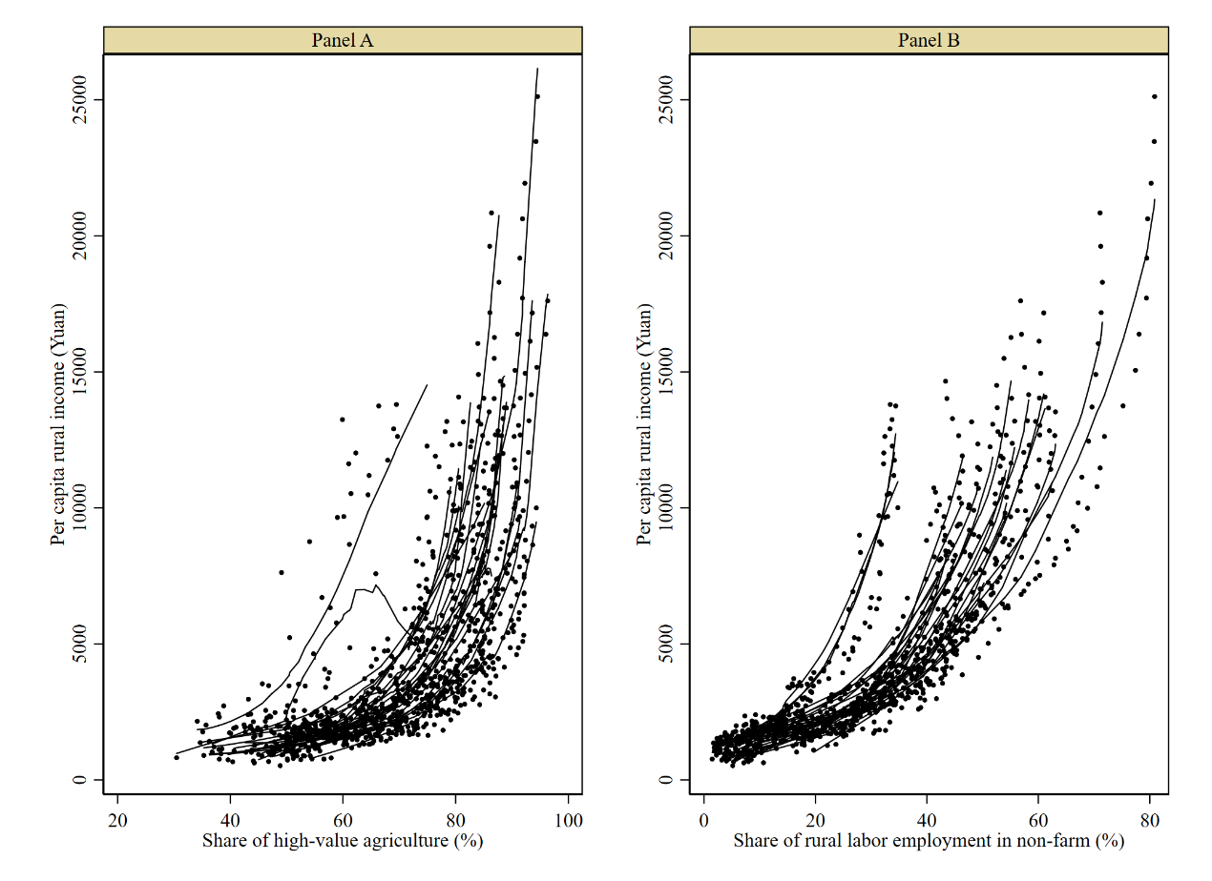
Rural transformation and per capita rural income by province in 1978‒2018
Share of high-value agriculture
Share of non-farm employment

Slide 7
Challenges
Income disparity between rural and urban, across regions and among farmers within same region: Despite per capita rural household real income grew at average of 7.3% annually in past 4 decades, the above income disparities remain HIGH.
Rising feed and food imports: Despite average 5.4% annual growth of agricultural production in the past 4 decades, feed and food import have been rising since the early 2000s (shifted from net exporter to importer in 2004).
Resource and environmental degradations: Past production growth has been at the expense of resource and environmental degradation.

Slide 8
Pathway of and IPIs to facilitate rural transformation
Stage | Path of Transformation | Major Institution, Policy & Investment (IPIs)
1 | Primary on staple food production | Institution (land) + irrigation + tech-1 (green revolution)
2 | Agri. diversification & commercialization | Plus agri. mkt + road infrastructure + tech-2
3.1 | Farming + part time off-farm | Plus labor. mkt + local land mkt + tech-3
3.2 | Mechanization + full time off-farm | Plus land transfer platform + custom services + credit + tech-3
4 | High-value; efficient, greener and sustainable agri.; Integrated urban-rural development | ???
Plus tech-4 (e.g., BT+DT) + new IPIs: for productive, inclusive & greener agri. & rural transformation
Major challenges: Income disparities, increasingly feed and food imports, and resource and environmental degradations

Slide 9
Pathway of and IPIs to facilitate rural transformation
Potential roles of DT to deal with the challenges and modernize agri. & rural:
Raise farmer income through gains in production & marketing, including farmers in remote regions;
Reduce labor use and improve farm mgt or raise productivity, which lowers feed and food imports;
Improve efficient uses of land and water and reduce chemical uses, which facilitates greener and sustainable agriculture;
Modernize agri. and rural through DT+BT, DT+IPIs, DT+others…
 | Stages of RT | Major IPIs
1 | Primary on staple food production | Institutions (e.g., land) + irrigation + tech-1
2 | Diversification/commercialization | Plus agri. mkt + mkt/road infrastructure + tech-2
3.1 | Farming + part time off-farm | Plus labor mkt + local land mkt + tech-3
3.2 | Mechanization + full time off-farm | Plus land consolidation + custom service + credit +tech-3
4 | High-value; efficient, greener and sustainable agri.; Integrated urban-rural development | Plus tech-4 (e.g., BT+DT) + new IPIs: for productive, inclusive & greener agri. & rural transformation

Slide 10
Outline of Presentation
Potential roles of digital technologies in agricultural and rural development
Efforts to facilitate digital agricultural and rural development
Emerging trends of digital agriculture and rural
Challenges and concluding remarks

Slide 11
Efforts on digital agricultural and rural development
Number of the State Council policy documents
addressed ICT and e-Commerce

Slide 12
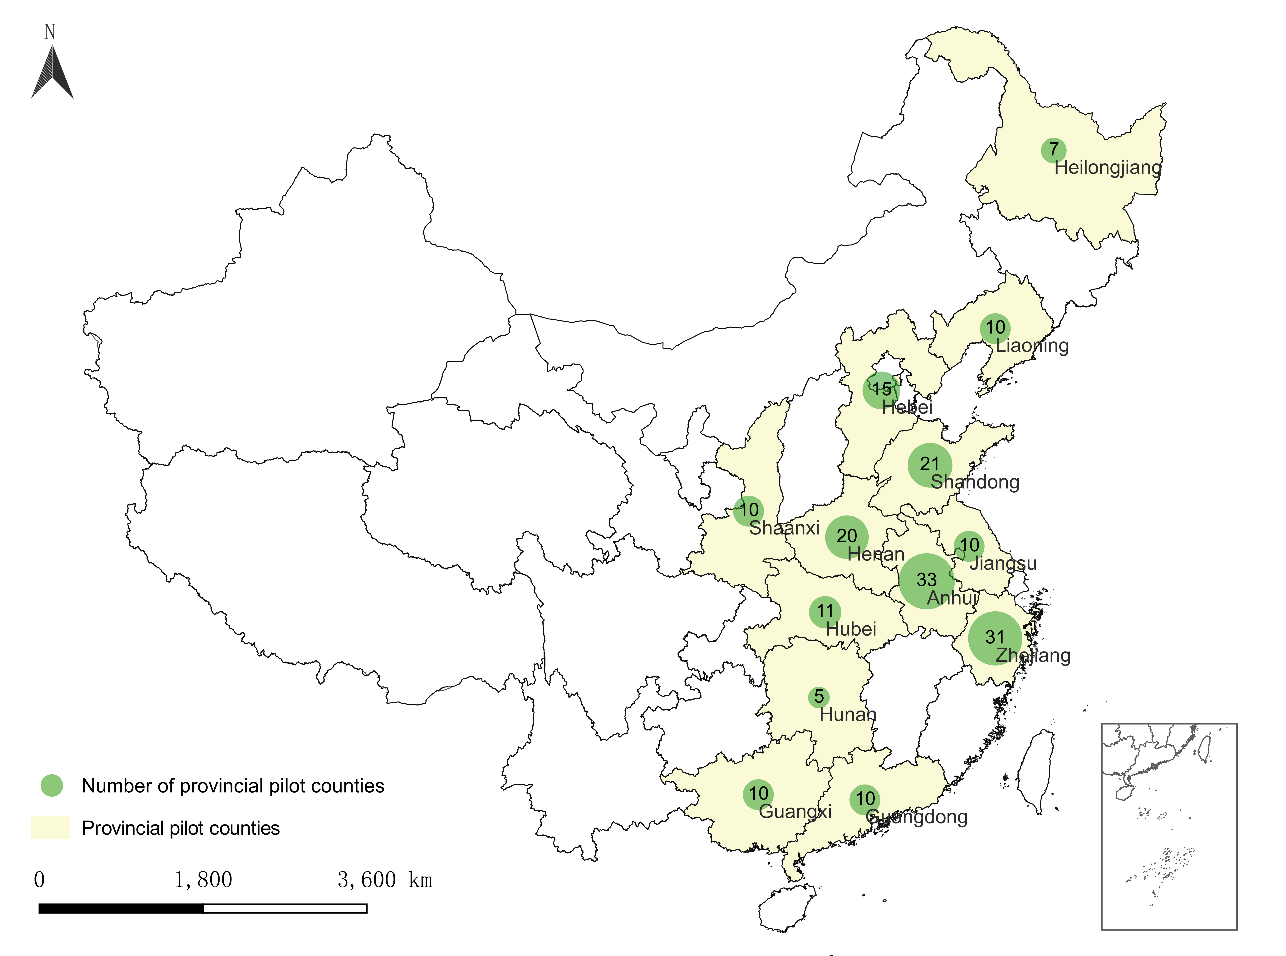
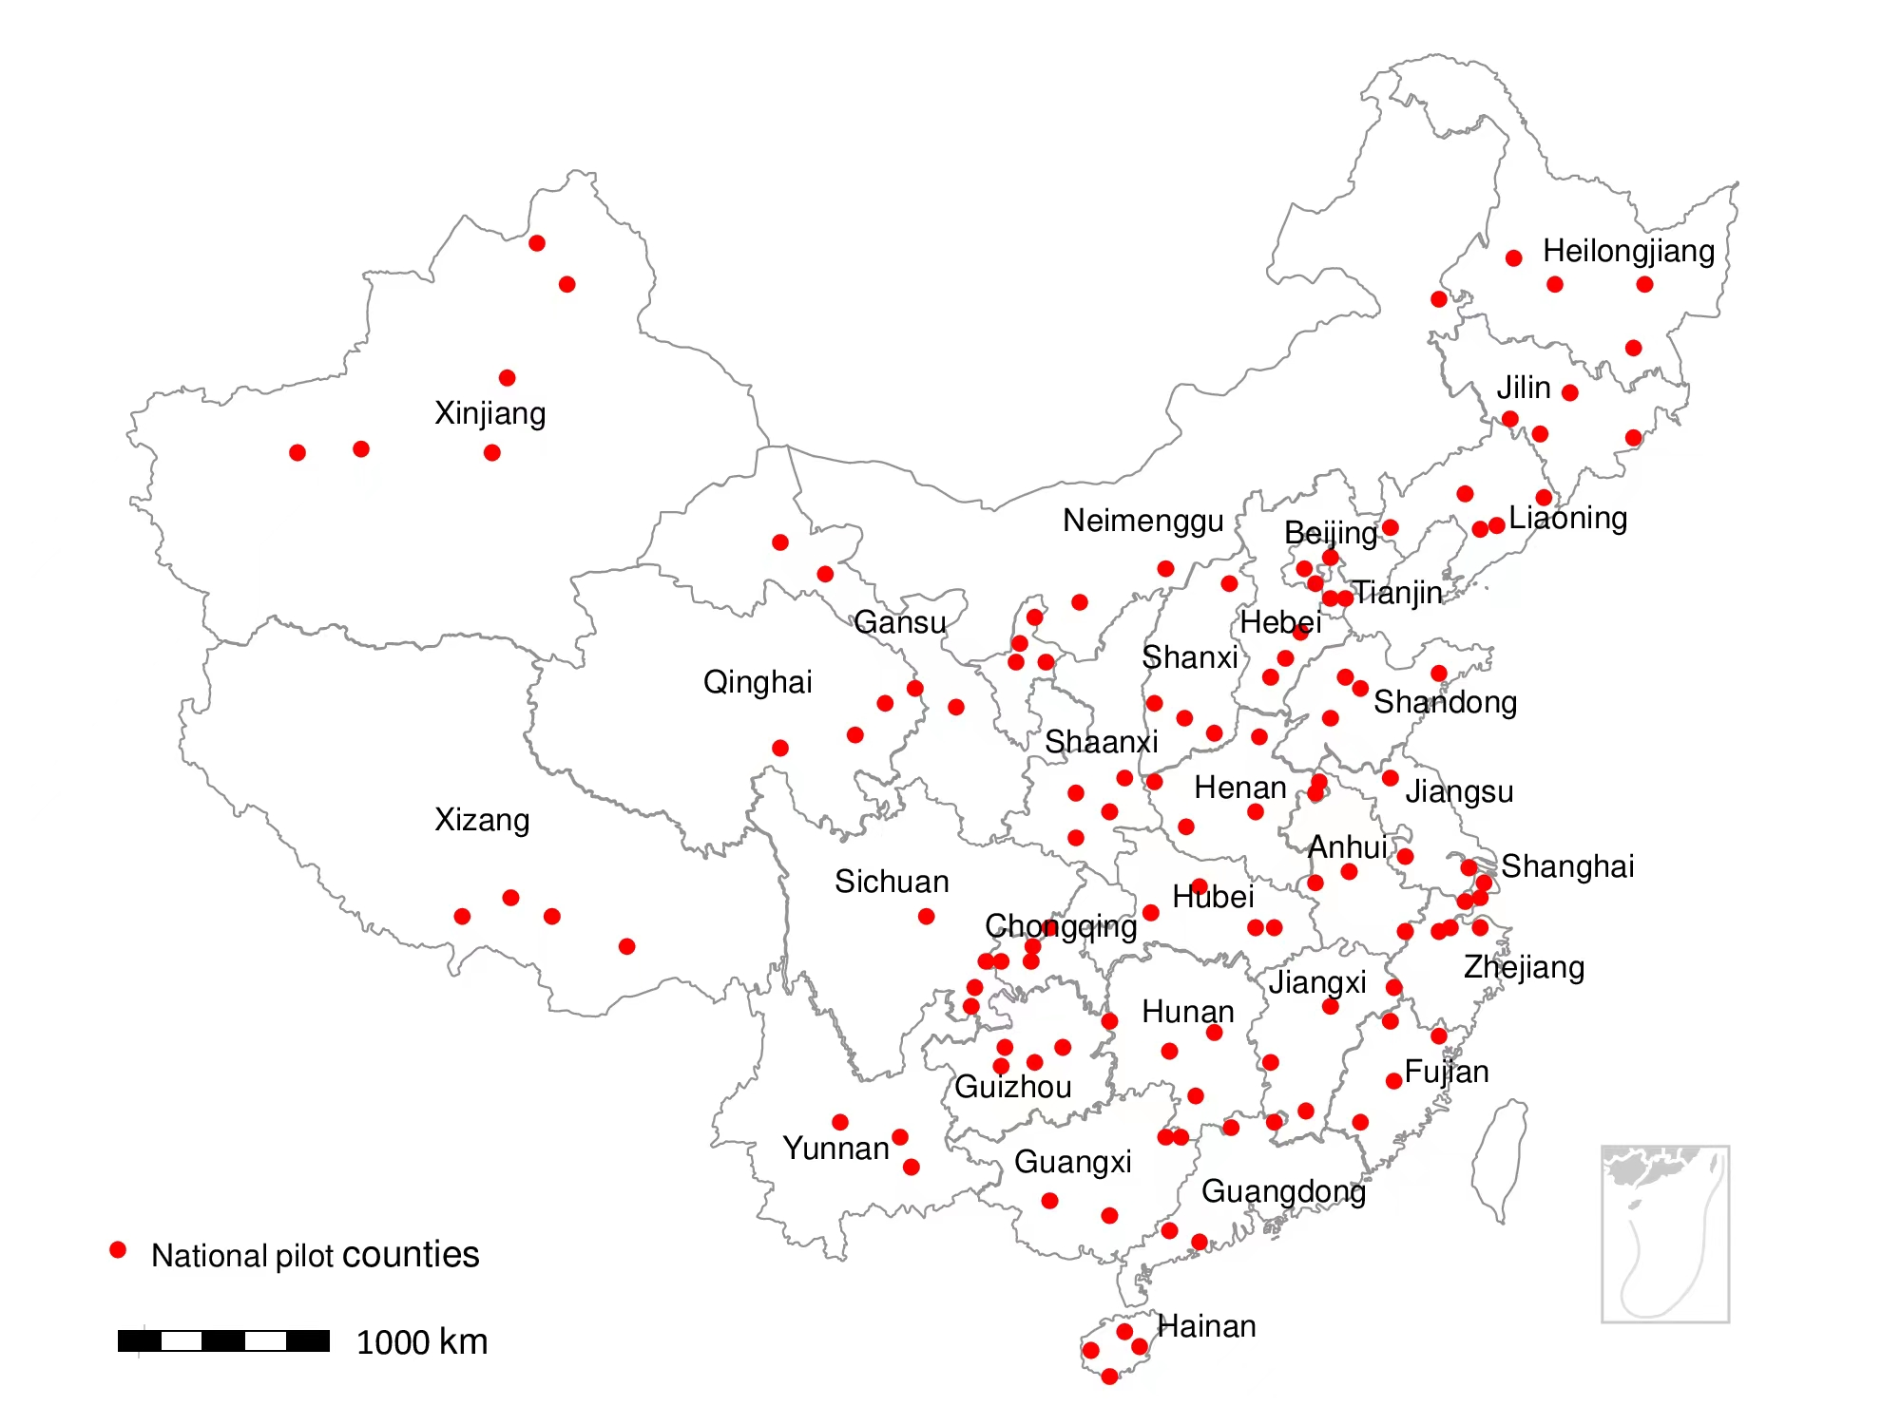


Major Government’s Pilot Programs
  Engineering experiments of agri. Internet of Things (IoTs) by MARA: started in 2013 in 9 provinces/cities.
  Digital agriculture pilot projects by MARA: 92 projects in marketing chain of major agri. products in 13 pilot counties since 2017; whole regional DA pilot in Suzhou, Jinan, Qindao and Weifang since 2020.
National digital rural pilots by several ministries in 117 counties in 2020
Provincial digital rural pilots: most provinces in 2021
13 provinces w/ data

Slide 13
The national e-commerce demonstration counties
by the Ministry of Commerce, 2014-2021

Slide 14
    Fiscal support: subsidies for drone as an example
Subsidies in 2018-2020
Province | Budget (mil. yuan) | Subsidy/drone (yuan)
Jiangsu | 20 | 14000
Shandong | 10 | 10000-30000
Gansu | 10 | 16000
Hubei | 10 | 15000
Chongqin | 10 | 16000-29000
Jiangxi | 10 | 15000-20000
Jilin | 10 | 15000
Hunan | 10 | 16000
Zhejiang |  | 17000-20000
Guangdong | 10 | 14400-21200
Anhui |  | 16000
Henan |  | 37200-75000
Fujian |  | 13000-16500
Shaanxi |  | 16000
Ningxia | 10 | 17000-21000
In 2017, drone subsidy pilot in 6 provinces.
      By 2020, nearly all provinces started the subsidies : 1/3~1/2 of the sales prices.
      In 2021, plant protection drone is included in the national agri. machinery subsidy program.

Slide 15
National policies to accelerate digital agri. and rural development
Year | Documents | Main contents about digital agriculture
2012 | Recommendations on Accelerating the Innovation of Agricultural Science and Technology and Continuously Enhancing the Ability to Guarantee the Supply of Agricultural Products | Accelerating the research of frontier technology, and making major breakthroughs in precision agriculture technology
2013 | Recommendations on Accelerating the Development of Modern Agriculture and Further Enhancing the Vitality of Rural Development | Strengthening scientific and technological innovation, and promoting research of agricultural machinery and equipment
2014 | Recommendations on Comprehensively Deepening Rural Reform and Accelerating Agricultural Modernization | Establishing a whole-process agricultural ICT application and mechanization technology system focusing on Agricultural Internet of things and precision equipment
2015 | Recommendations on Strengthening Reform and Innovation and Accelerating Agricultural Modernization | Making major breakthroughs in biological breeding, intelligent agriculture, agricultural machinery and equipment, and ecological and environmental protection
2016 | Recommendations on Implementing the New Concept of Development, Accelerating Agricultural Modernization and Realizing the Goal of Moderately Prosperous Society in All Respects | Vigorously promoting "Internet Plus" modern agriculture and developing smart meteorology and agricultural remote sensing technology
2017 | Recommendations on deepening the promotion of agriculture and accelerating the cultivation of new driving forces for agricultural rural development | Accelerating scientific and technological research and development, implement the smart agriculture project
2018 | Recommendations on Implementing the Strategy of Rural Revitalization | Vigorously developing digital agriculture, implementing smart agriculture, forestry , and advancing experiments and demonstrations on the Internet of Things and the application of remote sensing technology
2019 | Recommendations on Adhering to the Priority Development of Agriculture and Rural Areas and Doing the Work of "Agriculture, Rural Areas and Peasantry" well | Promoting independent innovation in the biological seed industry, heavy agricultural machinery, smart agriculture, and green inputs
2019 | Outline of Digital Rural Development Strategy | Consolidating the foundation of digital agriculture, promoting the digital transformation of agriculture, promoting the intelligent agricultural equipment
2020 | Recommendations on Focusing on the Key Work in the Areas of Agriculture, Rural Areas and Peasants to Ensure the Realization of a Moderately Prosperous Society in All Respects on Schedule | Building agricultural and rural big data center, accelerating the application of modern information technology
 | Plan for Digital Agriculture and Rural Development toward 2025 | Accelerating the digital transformation of planting, animal husbandry, fishery, seed industry and new forms of business.
2021 | Recommendations on Comprehensively Promoting Rural Revitalization and Accelerating Agricultural and Rural Modernization | Developing smart agriculture, establishing a big data system for agriculture and rural areas

Slide 16
Plan for Digital Agriculture (DA) and Rural Development towards 2025
The goals of development
Largely complete the construction of agricultural data collection system, the “Space-Sky-Ground” integrated observation network, the basic data resource system, and cloud platform.
Have significant progress in digital transformation of agricultural production, operation, management and service.
Gradually improve rural digital governance system.
Main indicators of DA towards 2025
 | 2018 | 2025
Share of DA in agri. GDP (%) | 7.3 | 15
Share of online retails of agri. products (%) | 9.8 | 15
Internet penetration rate in rural areas (%) | 38.4 | 70
…

Slide 17
Main areas: Plan for Digital Agriculture and Rural Development towards 2025
Main dimensions | Main contents
Basic data resource system | Agricultural natural resources, important agricultural germplasm resources, rural collective assets, homestead, farmers and new agricultural management entities
Digital transformation of production | Informatization of planting industry, intellectualization of animal husbandry, intellectualization of fishery, digitization of seed industry, diversification of new formats, and whole process control of quality and safety
Digital transformation of management and service | Agricultural and rural management decision support system, monitoring and early warning system of the whole industrial chain of important agricultural products, digital agricultural and rural service system
Key technology and equipment innovation | Main common technology tackling, technology integration application and demonstration, agricultural artificial intelligence R & D and application
New infrastructure construction | Agricultural and rural big data center, integrated observation system of “Sky-Ground-Space”, and innovative projects

Slide 18








Private investment from major agricultural companies
Agricultural enterprise | Main business | Fields of digital development
 | Pig breeding | Establish an intelligent digital platform covering feed processing, pig breeding and sales
 | Agriculture and food | IoTs and artificial intelligence drive the digital transformation of agricultural industry
 | Feed production and breeding | Intelligent fishery breeding driven by IoTs and big data
 | Crop and breeding | IoTs and AI used in breeding based on cloud platform of Huawei
 | Feed, breeding, and crops | Digitalization in management, transcation, and services in pig breeding
 | Rice and other crops | IoTs, intelligent machinery and blockchains enable planting
 | Feed and breeding | Intelligent breeding equipment
 | Agricultural machinery | Intelligent agricultural machinery relating to wheat, corn and rice, etc.

Slide 19
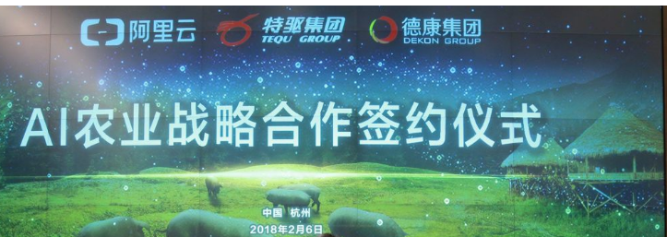
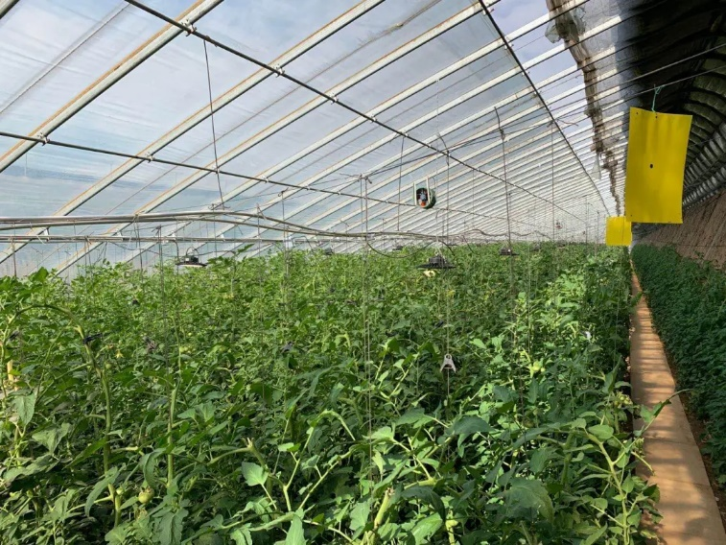
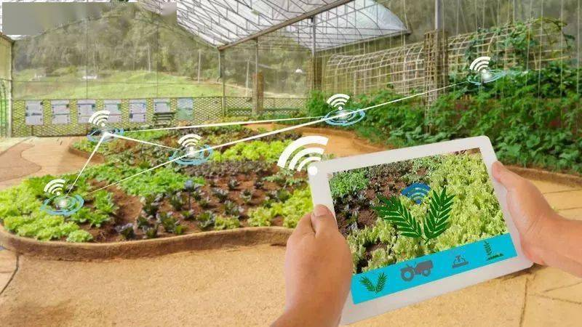
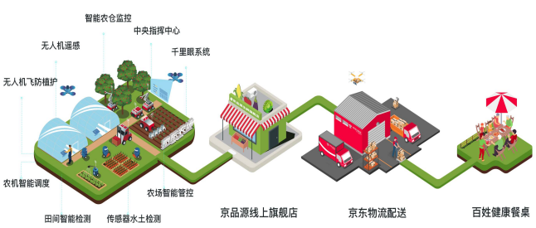
  Private investment from internet companies
  Alibaba Cloud
  AI in pig breeding programme
  Tencent AI Greenhouse planting
  Jingdong farm:
  Drone service platform used in the whole process
  Huawei
  5G/AI enable farms

Slide 20
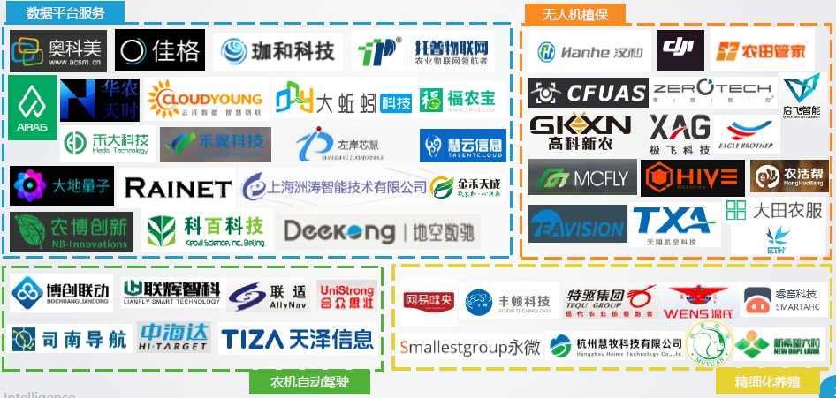
Major companies involved in different applications or trails of digital agriculture
Data platform services
Drone for plant protection
Smart agricultural machinery
Delicacy breeding

Slide 21
Outline of Presentation
Potential roles of digital technologies in agricultural and rural development
Efforts to facilitate digital agricultural and rural development
Emerging trends of digital agriculture and rural
Challenges and concluding remarks

Slide 22
ICTs infrastructure in China
Rising number of internet and smartphone users (Million), 2007-2020
Rising internet penetration (%), 2007-2020
Rising mobile base stations (million):
4G = 5.84m; 5G = 1m
Source: Authors’ compilation based on CNNIC’s annual reports.

Slide 23




Digital logistics in rural China in 2020
30,000+ express outlets
63,000+ public stations
Covers 98% of townships
30+ billion express number
50% directly delivered to villages
 | Covers >1,000 counties and establish >30,000 rural service outlets
 | 1,500 county/town-level service centers, covers 30,000 twoships
 | Covers almost all counties, serving > 550,000 Villages
 | Covers 41,463 townships, 83%

Slide 24
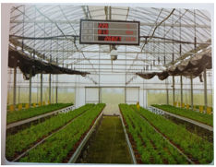
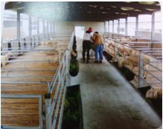
IoTs tech. has been applied in some fields in agriculture
  Fields of application: staple crops, horticulture, livestock and aquaculture.
  Main function: online monitoring, precision operation, digital management.
  Potential impacts: improving monitoring efficiency, reducing operating costs, promoting scientific management decisions
Installation f agricultural IoT equipments (million Set)
Agricultural IoT industry (billion Yuan)
Suzhou Shenyuan Biotechnology Co., Ltd
Duqiao agriculture professional cooperative, Wuzhong District, Suzhou City

Slide 25
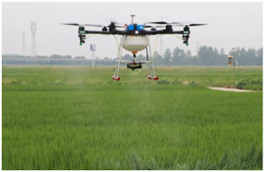
Applications of agricultural drone
  Increasing uses of drone in plant protection. Number of drone exceeded 100,000 in 2020, and the serviced area has increased significantly.
  Expanding application fuctions. From field crops to cash crops, from single plant protection to sowing, fertilization and other fields.
  Potential impacts: Enhancing the accuracy of operation, saving the uses of pesticide, fertilizer and labor, etc.
Serviced area and # of drones

Slide 26
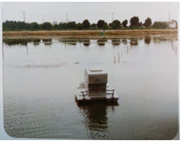
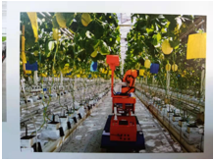
Progress in automatic agricultural robots
Market sales volume (1,000 Set)
Policy support: subsidies, Beidou satellite networking, unmanned farm project
Market scale: Beidou terminal installation exceeds 2.3 million sets in 2020, agri. automatic driving system sales volume of 17 thousand sets
Potential impacts: Precision operation in harvesting. Automatic feeding and fish disease control in aquaculture. Time-saving and long operation duration.
Market sales scale (million Yuan)
Kunshan Chenghu aquatic products Co., Ltd
Suzhou Changshu national agricultural science and Technology Park

Slide 27
E-commerce
Retails of consumption goods through e-commerce (%)
Number of Taobao Villages
Sources: Based on the data from Alibaba and China Statistical Yearbook

Slide 28
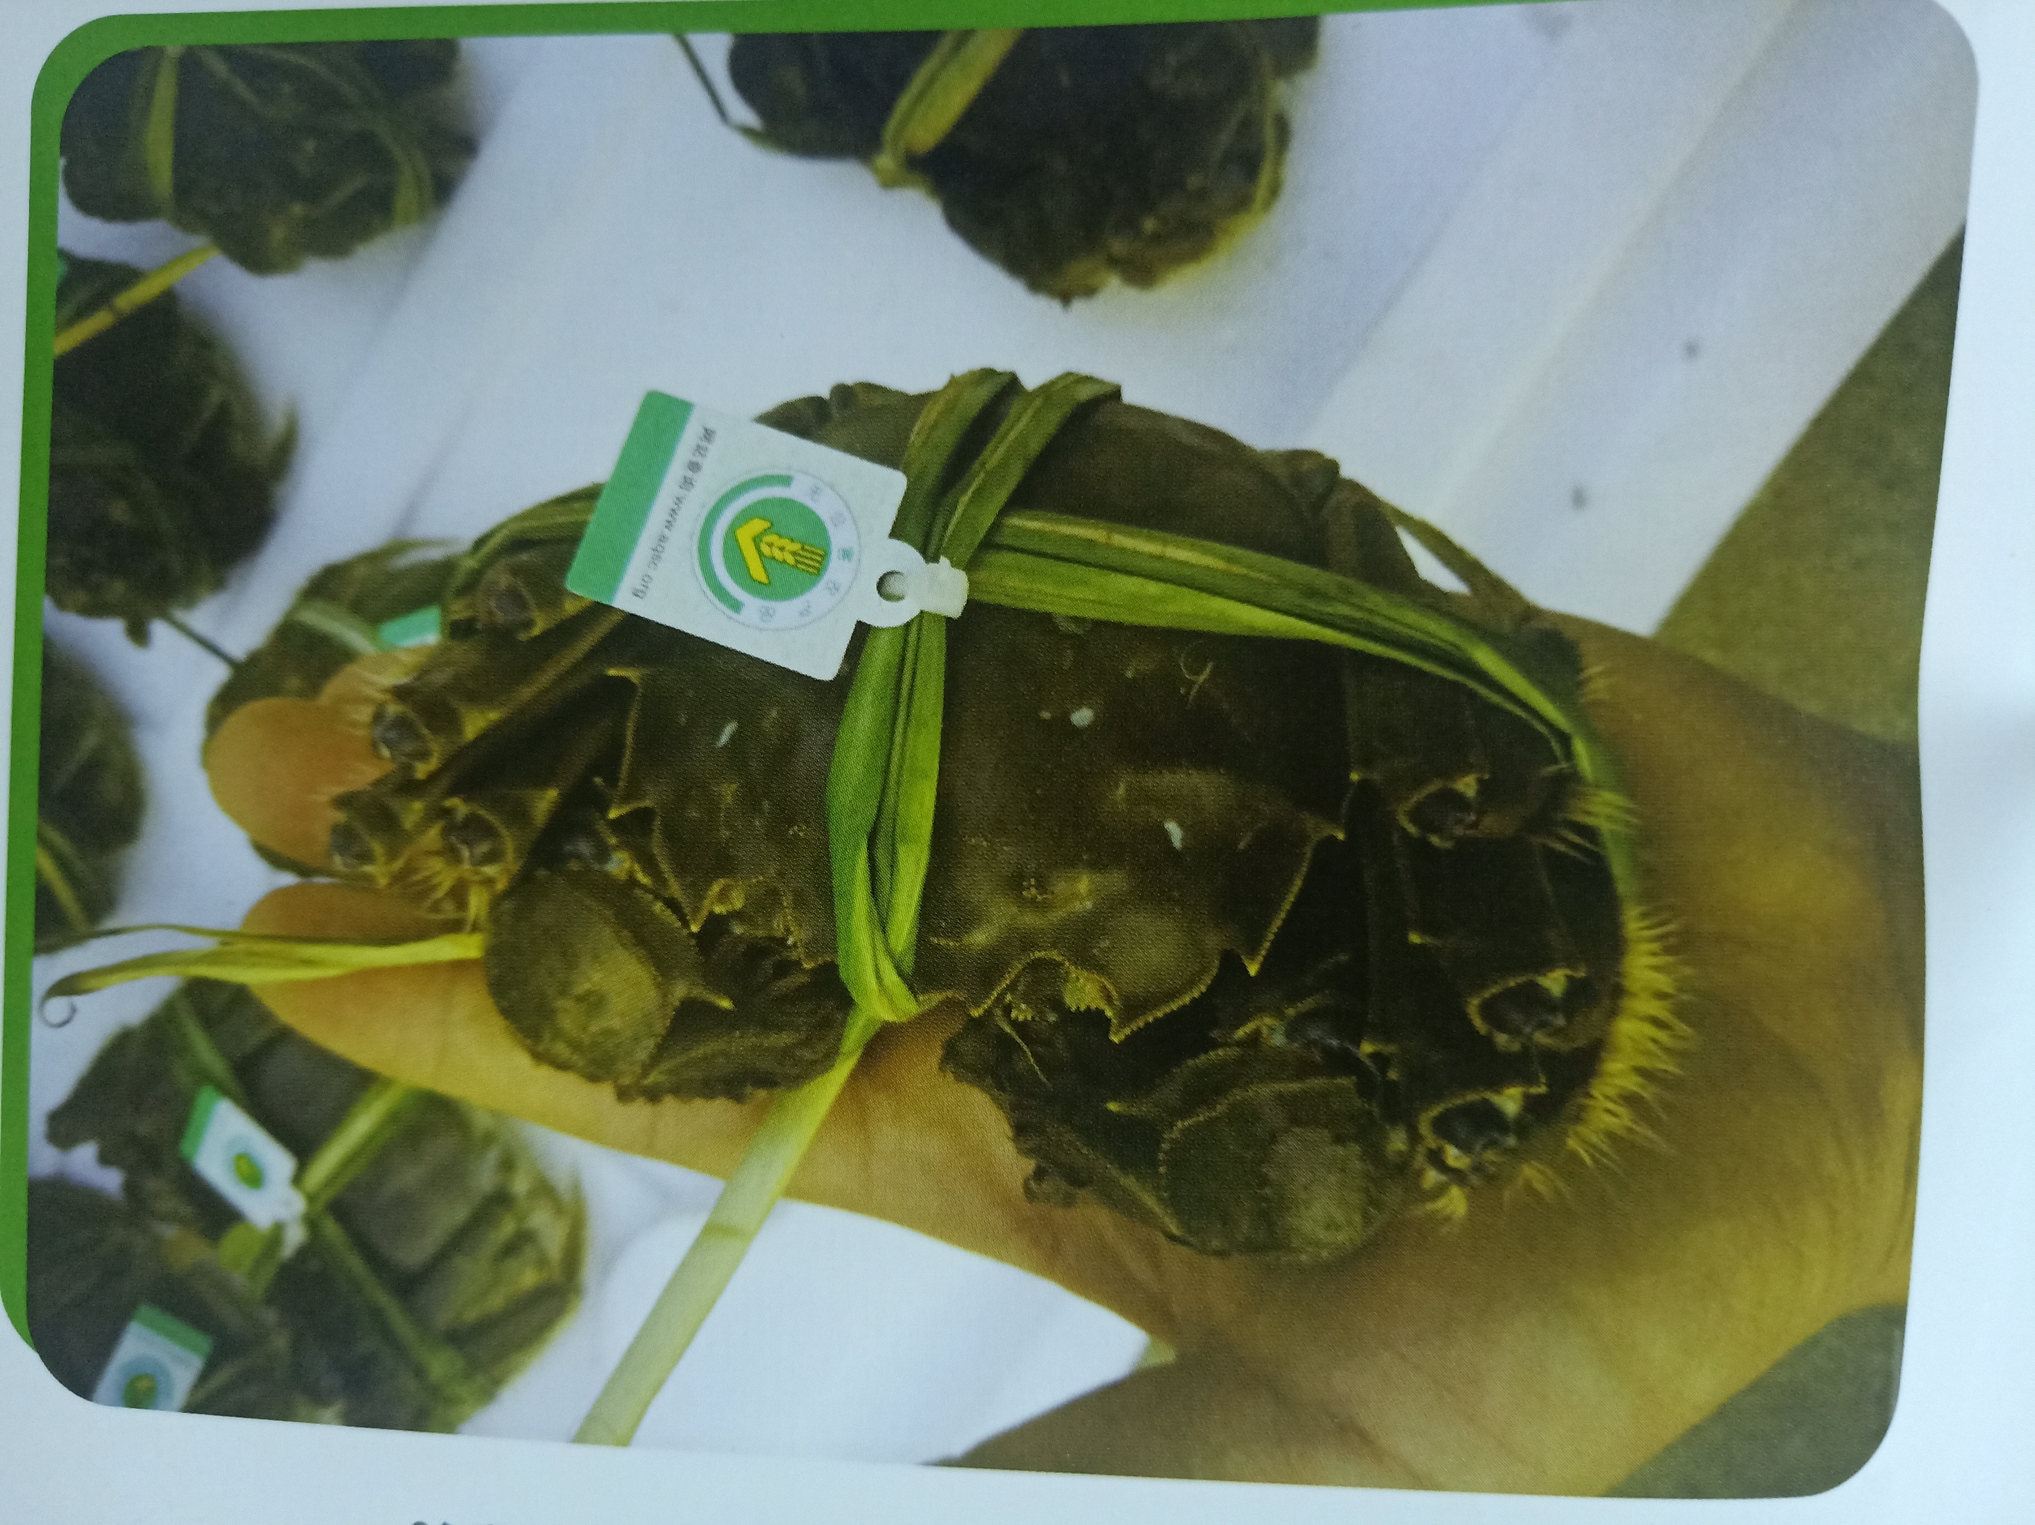
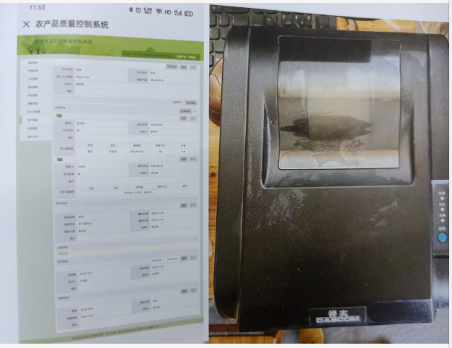
Exploration of blockchain in food traceability
Potential roles
  Safety production management
  Circulation management
  Quality supervision & traceability
Examples: Agricultural product quality safety and management traceability
Songling zhumaogen aquatic professional cooperative, Wujiang, Suzhou

Slide 29
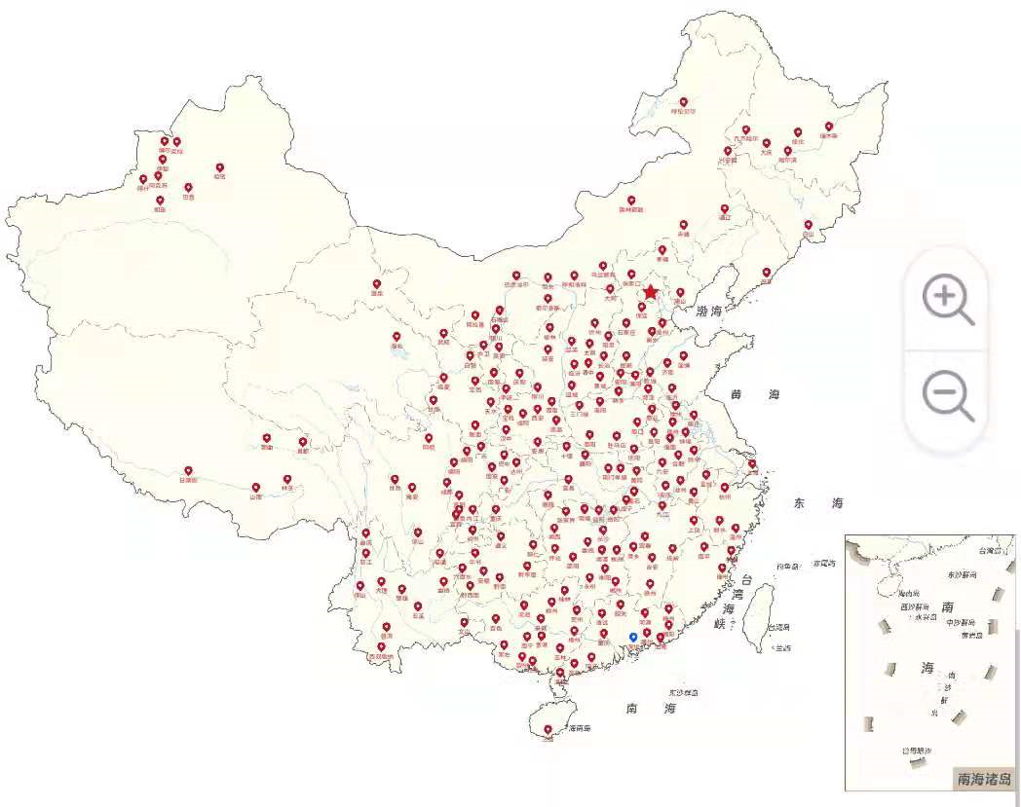
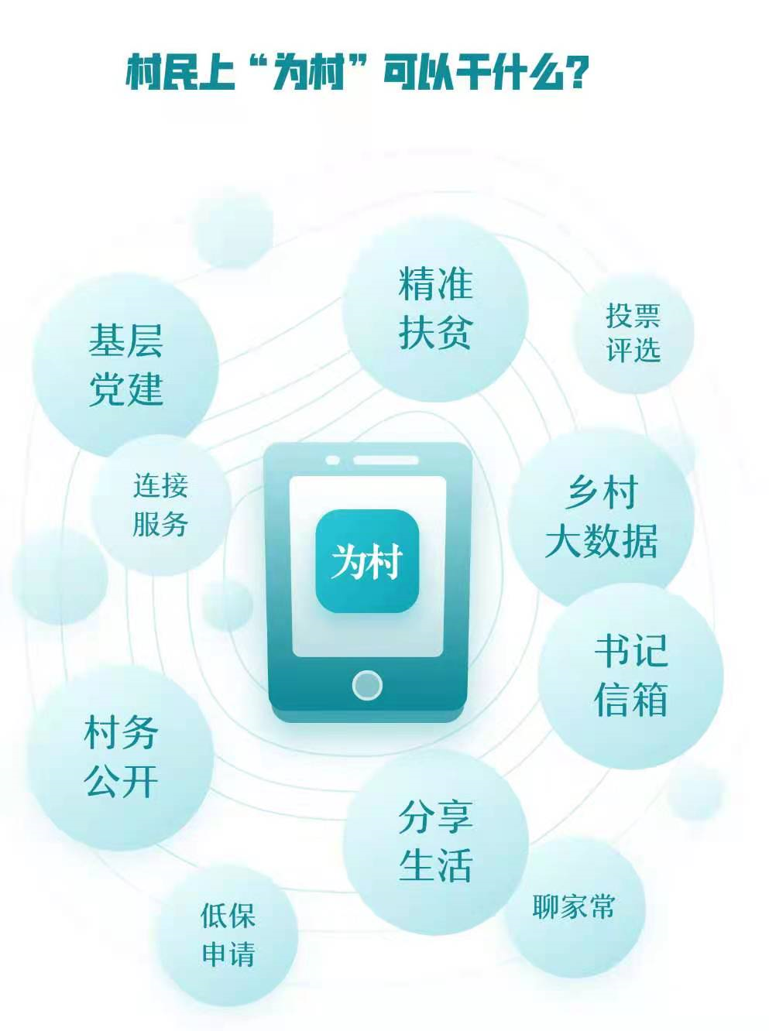
Digital technologies used in rural governance
Tencent WeCounty as an example
Tencent WeCounty
  30 provinces, 893 counties, 2,458 townships, 16,605 villages; 2,538 thousand people
Telecom “Cuncunxiang”
  10 provinces, 1,000 counties
Alibaba Rural Ding:
  23 provinces, >100 counties

Slide 30
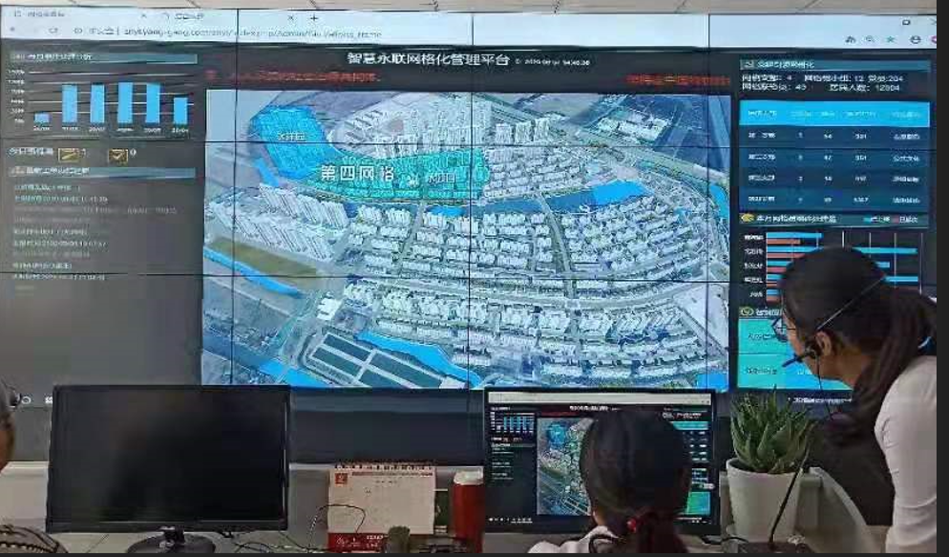
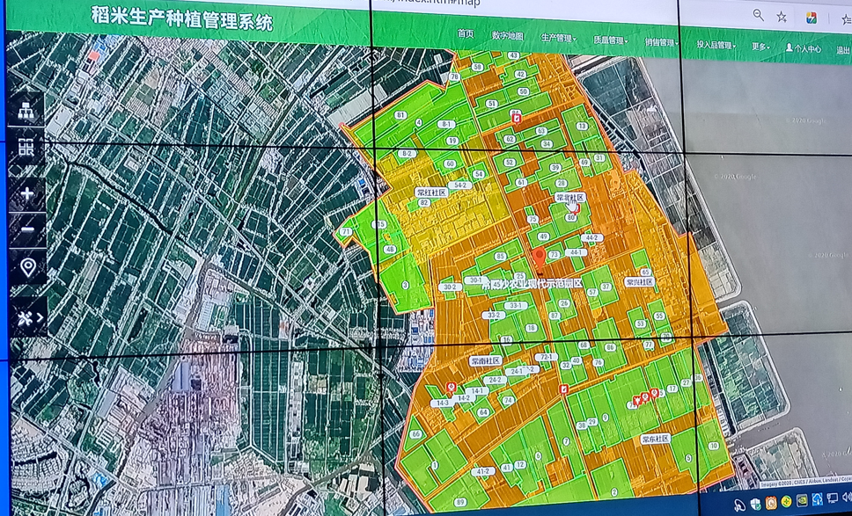
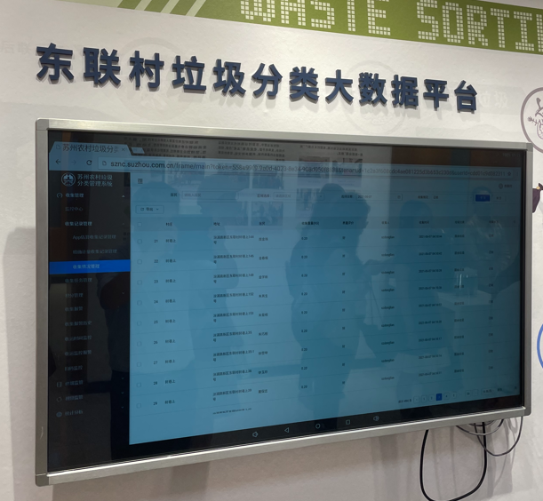
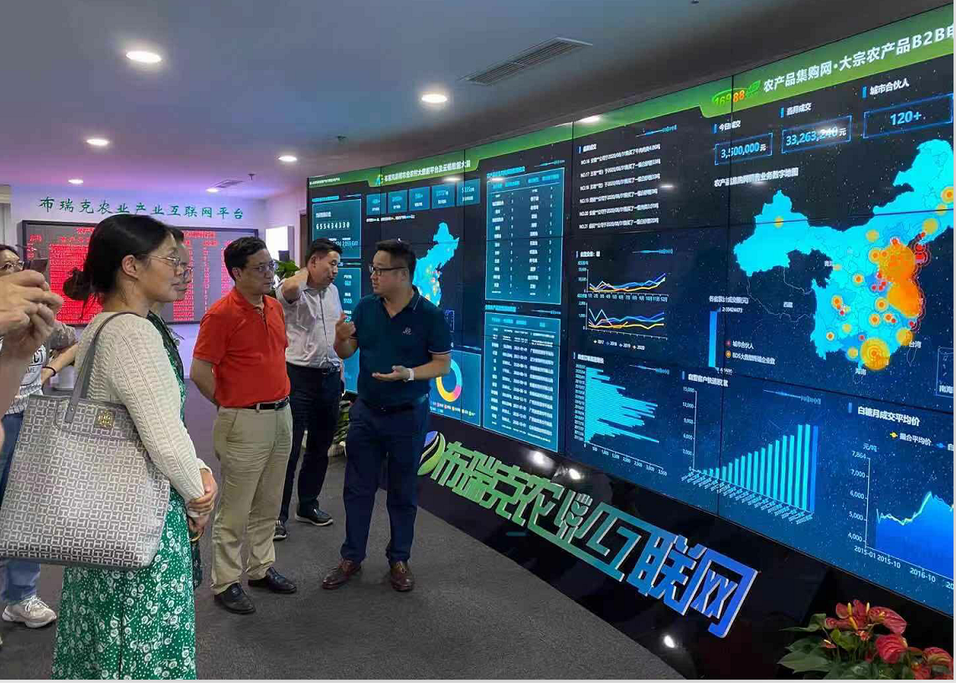
Digital technologies used in rural governance
IoT used in rural grid MGT
Big data + land and asset MGT
IoT used in garbage classification
Big data platform: market services

Slide 31
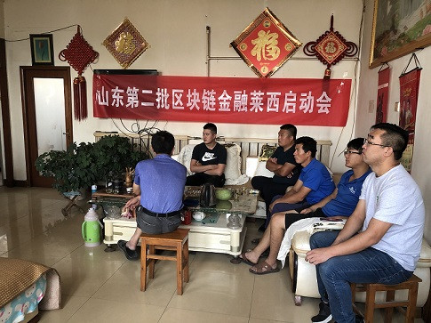
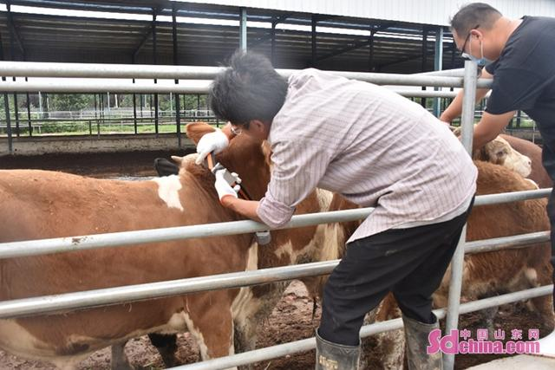
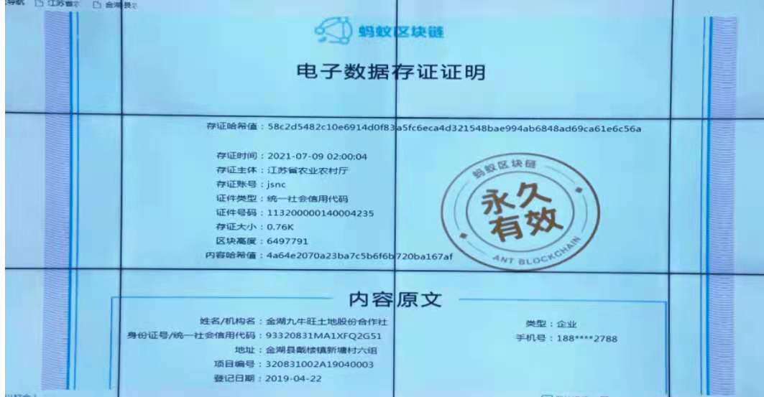
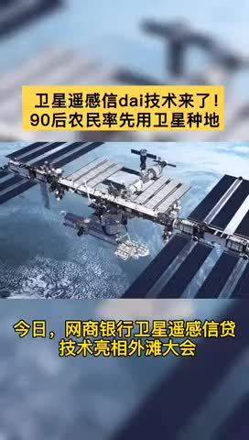
Digital technologies used in rural finances
Blockchain + agricultural materials supply
Blockchain + property mortgage loans
Satellite remote sensing technology + credit
Blockchain, drones + insurance claims
Breeding
insurance
Information chains
Death of livestock
Compensation amount
Information system
Farmers
Insurance company
Underwritting data chains

Slide 32
Outline of Presentation
Potential roles of digital technologies in agricultural and rural development
Efforts to facilitate digital agricultural and rural development
Emerging trends of digital agriculture and rural
Challenges and concluding remarks

Slide 33
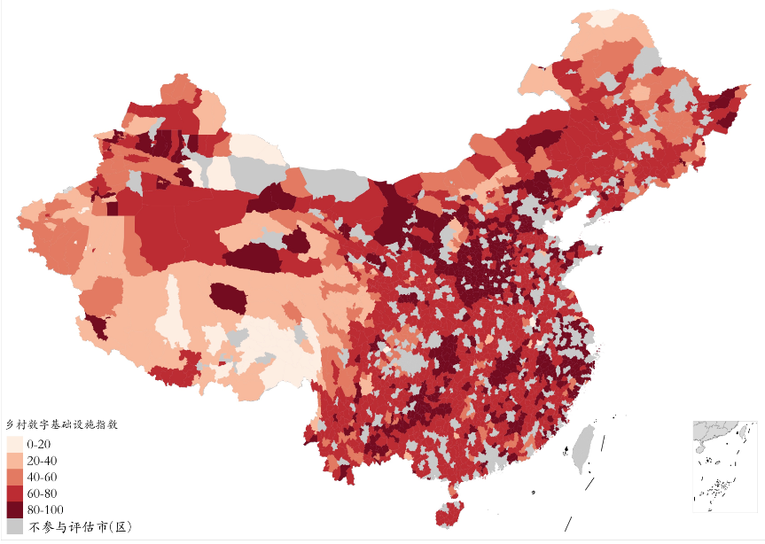
Rural digital infrastructure index
High (30%), relatively high (51%) , medium (11%),
relatively low (6%) and low (2%)
Index:
Access to mobile device
Digital financial infrastructure
Digital commercial landmark
Application of dynamic monitoring and response system
Rural digital infrastructure
not involved in the assessment
Source: Report of County digital rural index (2018) , CCAP and
New Rural Development Research Institute, Peking University

Slide 34
Inclusiveness
Share of households (N=13,570) with computer and internet, 2015-2019
 | Computer (%) | Internet (%)
Total | 30 | 70
Household head by gender
Male | 30 | 70
Female | 20 | 52
Household head by age
16-30 | 48 | 89
31-45 | 40 | 84
46-60 | 36 | 77
Above 60 | 19 | 56
Household head by education
Elementary school or below | 22 | 62
Junior middle school | 34 | 76
High school or above | 46 | 79

Slide 35
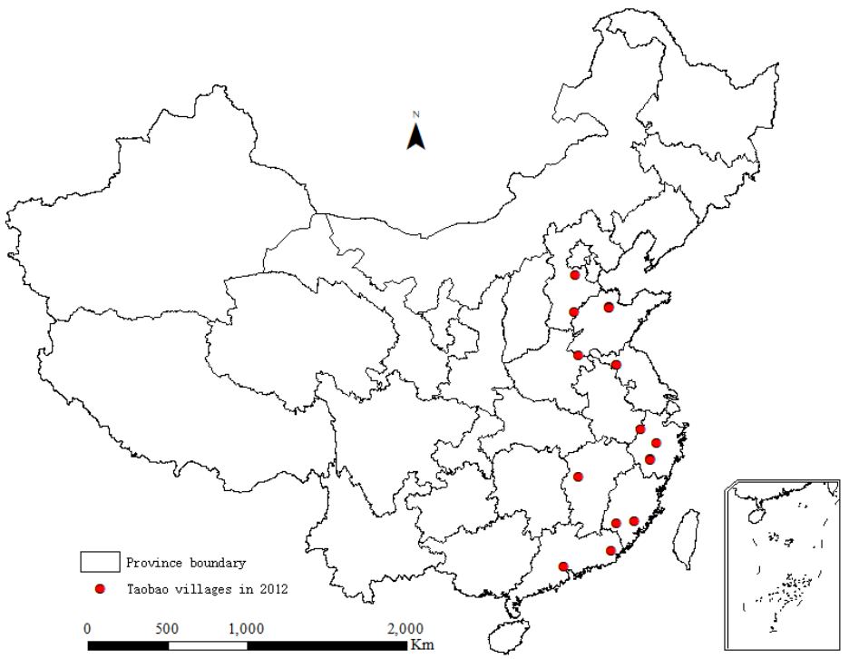
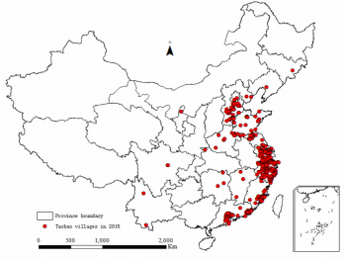
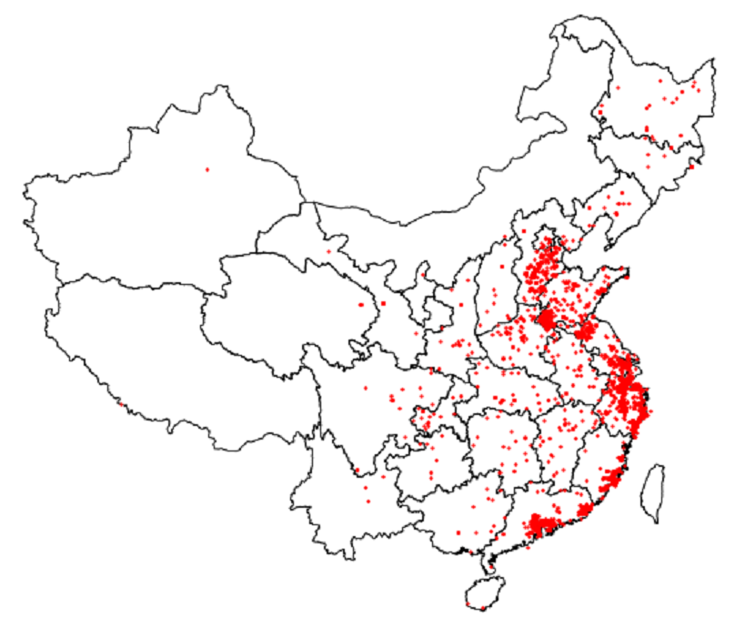


The spatial aggregation of Taobao villages
2012
2015
2019
2019

Slide 36
Share of rural households selling agr. products through e-commerce in 2016 and 2019
Farmers’ engagement in online sales is still low
Number of Taobao Villages in 2013-2020
still < 1% of total (690,000 ) in 2020
Value and share of rural online food sale
E-commerce (<1%) in 2016
E-commerce (2%) in 2019
Agri. e-commerce (1%) in 2019
Source: CCAP’s survey in 10 provinces
Source: The ministry of Commerce (2020)

Slide 37
Farmers’ marketing channels of fruits in the villages with advanced e-commerce in Zhejiang and Shandong, 2015-2019
Small farms benefited more from Wechat;
Observed rising food sold in e-commerce platform: not from farmers but others

Slide 38
Selling prices and marketing costs between e-commerce and non-ecommerce (yuan/kg)
 | E-commerce | Non-e-commerce | Diff. in mean
Apple
Selling price
Grade1 | 2.09 | 1.28 | 0.81***
Grade2 | 1.56 | 0.88 | 0.68***
Marketing cost
Grade1 | 0.66 | 0.14 | 0.52***
Grade2 | 0.60 | 0.13 | 0.47***
Peach
Selling price
Grade1 | 2.52 | 1.48 | 1.05***
Grade2 | 1.73 | 1.00 | 0.72***
Marketing cost
Grade1 | 0.78 | 0.13 | 0.65***
Grade2 | 0.72 | 0.13 | 0.59***
Notes: *** p<0.01, ** p<0.05, * p<0.10. Source: authors' calculations
Farmers gain significantly more by selling their products through e-commerce.
Higher value of agricultural product or better quality of the same product gains more from e-commerce.

Slide 39
Share of fruit producers engaging in e-commerce in the villages with advanced on-line business, 2015-2019
 |  | %
Total |  | 49
Decision-maker by gender
Male |  | 47
Female |  | 63
Decision-maker by age
16-30 |  | 82
31-45 |  | 61
46-60 |  | 47
Above 60 |  | 19
Decision-maker by edu
Elementary school or below |  | 31
Junior middle school |  | 45
High school or above |  | 64
Household by farm size
0.3 hectare or below |  | 44
0.3 - 1 hectare |  | 49
Above 1 hectare |  | 86

Slide 40
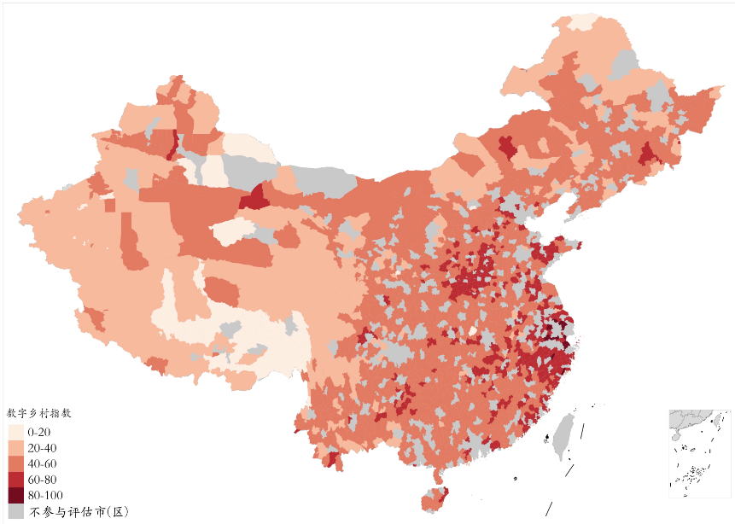
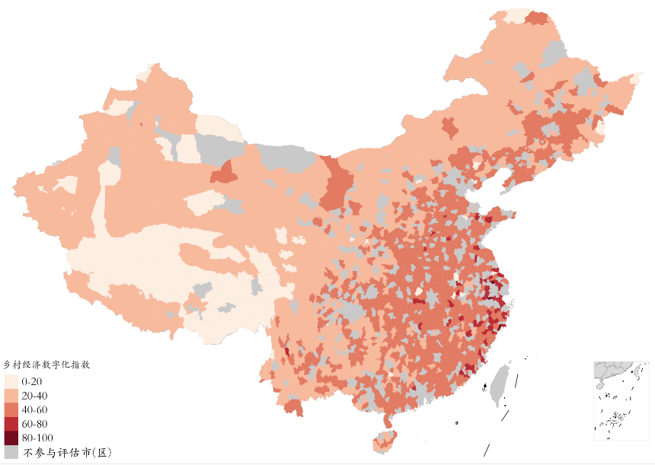
Large variation among regions in rural China
Digital village: high (0.7%), high (16.9%), medium (64.0%), low (16.0%) and low (2.4%)
Economic digitization: high (0.2%), high (3.2%), medium (51.7%), low (40.3%) and low (4.6%)
Digital village index
Rural digital economic index
not involed in the assessment
not involed in the assessment
Source: Report of County digital rural index (2018) , CCAP and New Rural Development Research Institute of Peking University

Slide 41
Concluding remarks
There are potential roles of using DTs to raise farmer’s income, improving productivity and food security, and facilitating greener and sustainable rural transformation.
Substantial efforts have been made by government and private sector. But, so far farmer’s adoption of DTs in agriculture is still limited.
More efforts should be made to assess what are appropriate DTs for small farms, enable and constraining factors affecting farmer’s adopting DTs and their diffusions.
There is strong evidence of big digital divide between regions and among farmers.
While there is great opportunity to modernize rural economy through DTs, a more inclusive development strategy should be made to avoid the less developed regions and some farmers left behind in the coming DT era.

Slide 42
Thank you!

